Slide 1
Career Predicctor

Slide 2
Index
Introduction
Project Definition
Project Features
Tools and technologies used
Scope of the Project
Future Enhancements
Flowchart

Slide 3
Introduction
In todays world, people have so many options of products ,movies, restaurant and their career domains. With so many different jobs available, it can be difficult for individuals to determine their skill and professional objectives. Sometimes an individual may get very confused about which career areas to process through. An individual continuously needs to evaluate skills, interest and certifications to decide their career paths. Recommender Systems are an integral aspect of daily life, since individuals rely on knowledge to make decision in their best interest.

Slide 4
Problem Statement
To build a career recommender system which recommends the best suitable career option for an individual.

Slide 5
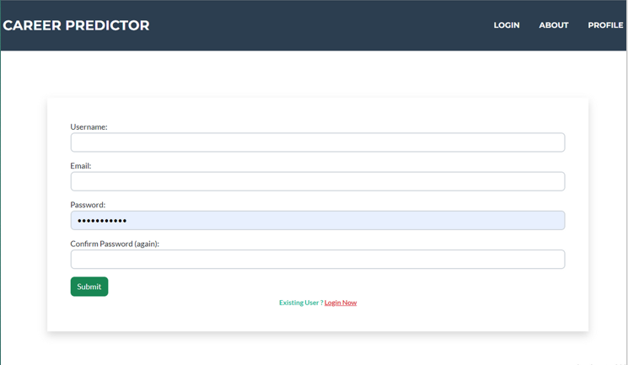
Project Features
Login/Signup page: Enables user to use the system by registering or logging in.

Slide 6
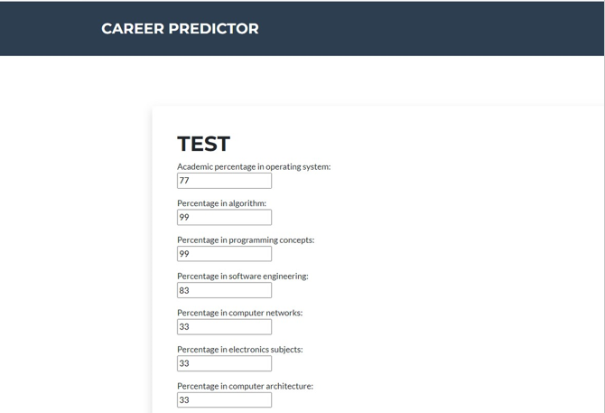
Project Features
Home page: Displays form that the user has to fill so the system can predict a career.

Slide 7
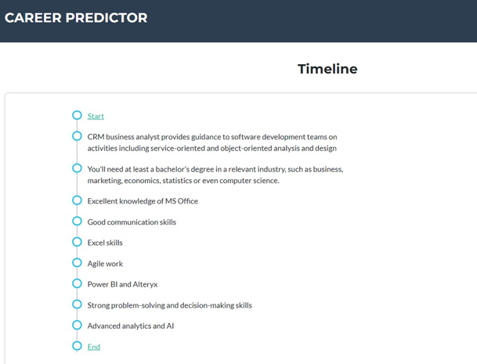
Project Features
Road map: After the career is predicted, the user will get a road map of how to go about to achieve it.

Slide 8
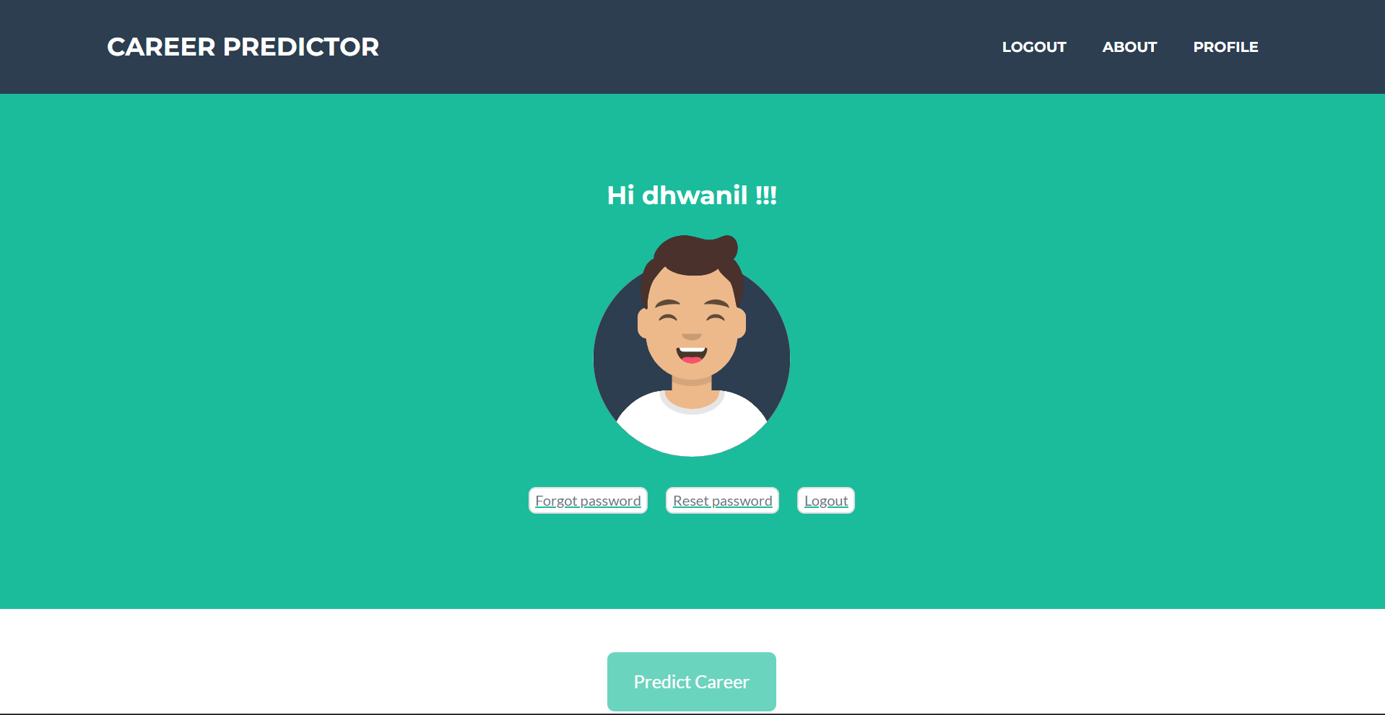
Project Features
Profile: It contains settings such as forgot password, reset password and take the test.

Slide 9
Tools and Technologies used
Dataset from Github
Front-end : Html, CSS, JavaScript
Back-end: Django(predefined sqlite database used), Python

Slide 10
Scope of the Project
A full stack website that supports users to find the best career opportunity for their overall growth. Users can find opportunities related to either their education or jobs. The website is facilitated using HTML, CSS, Javascript and Django. We have based our project on the machine learning algorithm “Naive-bayes” which is a probability-based algorithm for multi class classification.

Slide 11
Future enhancement
Every day new programs are introduced and continuously increasing. So further decomposition may be needed in order to have more specialized fields of study.
We can include a chat bot which will act as a assistant to the user for filling the form and also assist the user throughout the process.
We can also add add a feature in which we can suggest courses that will be an asset to the user for achieving their career goals. This will be done by Web scrapping.

Slide 12
Conclusion
As a conclusion, Indecisive prospective individuals are to be guided to select career paths. Further, existing solutions lacking in the use of students’ skills, interests and academic performance towards filtering a possible recommendation. The design process considered the factors such as academic performance of the user’s school results; his/her skills from activities and interests. The main benefit of Career Recommender System is the prospect to recommend a career path.

Slide 13
Thank You !!!
Project by:
Dhwanil Chauhan-20DCS011
Mehul Chauhan-20DCS012
Prakshal Bhandari-20DCS007

